Slide 1
Object Oriented Software Engineering (OOSE)
22CS017
Introduction to Class diagram
Lecture (Theory)
Prepared By Dr. Suvarna Sharma

Slide 2
Index
Introduction to Class diagram
Class diagram for:
College Information System
Library Management system
Hospital Management System
Online shopping system/Banking System
Practice Questions

Slide 3
Introduction to Class Diagram
1. Class diagram is a static diagram.
2. It represents the static view of an application.
3. Class diagram is not only used for visualizing, describing, and documenting different aspects of a system but also for constructing executable code of the software application.
4. Class diagram describes the attributes and operations of a class and also the constraints imposed on the system.
5. The class diagrams are widely used in the modeling of object-oriented systems because they are the only UML diagrams, which can be mapped directly with object-oriented languages.
6. Class diagram shows a collection of classes, interfaces, associations, collaborations, and constraints. It is also known as a structural diagram.

Slide 4
Purpose of Class Diagram
Analysis and design of the static view of an application.
Describe responsibilities of a system.
Base for component and deployment diagrams.
Forward and reverse engineering.

Slide 5
Building Blocks of Class
Diagrams
A UML class diagram consists of the following building blocks:
1. Class
A class is a blueprint or template that defines the properties and behavior of an object.
Represented as rectangles, classes are divided into three compartments:
Name (top compartment): The unique identifier of the class (e.g., BankAccount).
Attributes (middle compartment): The properties or data associated with the class (e.g., accountNumber, balance).
Operations (bottom compartment): The actions or methods that can be performed by objects of the class (e.g., deposit(), updateBalance()).
BankAccount
accNumber balance
Deposite Withdraw updateBalance getAccInfo
Figiure 1. Class Representation

Slide 6
Building Blocks of Class
Diagrams Cont..
2. Attributes
Attributes in a UML class diagram represent the properties or data fields of a class.
3. Methods
Methods (or operations) in a UML class diagram represent the functions or behaviors that a class can perform.

Slide 7
Multiplicity
How many objects of each class take part in the relationships and multiplicity can be expressed as:
Exactly one – 1
Zero or one - 0..1
Many - 0..* or *
One or more - 1..*
Exact Number - e.g. 3..4 or 6
Or a complex relationship - e.g. 0..1, 3..4, 6.* would mean any number of objects other than 2 or 5
Example
Requirement: A Student can take many Courses and many Students can be enrolled in one Course.
In the example below, the class diagram (on the left), describes the statement of the requirement above for the static model while the object diagram (on the right) shows the snapshot (an instance of the class diagram) of the course enrollment for the courses Software Engineering and Database Management respectively)

Slide 8
Types of relationship between
classes
Association: Similar to relationships that connect objects, associations connect classes. Assuming we have two classes that interact, there must be a continuous connecting line between them, denoting an association in the diagram. Often, we can also see a verb conveying its meaning. In addition, we can also specify the multiplicity, that is, the number of objects that can take part in the relationship.
Inheritance: This is a schematic representation of the relationship between a parent class and its descendants.
Implementation: It usually refers to the relationship between an interface and the objects that implement it.

Slide 9
Types of relationship between classes Cont..
Dependency: An object of one class can use an object of another class in its method. If the object is not stored in a class field, this type of interclass relationship is modeled as a dependency. Dependency is a special case of the association of two classes, wherein changes in one class will inevitably lead to changes in the other.
Aggregation: A special type of association between classes, wherein one class is part of another.
Composition: Essentially a kind of aggregation, only, in this case, classes that are part of another class are destroyed when the aggregator class is destroyed.

Slide 10
How to Draw a Class Diagram?
The following points should be remembered while drawing a class diagram
The name of the class diagram should be meaningful to describe the aspect of the system.
Each element and their relationships should be identified in advance.
Responsibility (attributes and methods) of each class should be clearly identified.
For each class, minimum number of properties should be specified, as unnecessary properties will make the diagram complicated.
Use notes whenever required to describe some aspect of the diagram. At the end of the drawing it should be understandable to the developer/coder.
Finally, before making the final version, the diagram should be drawn on plain paper and reworked as many times as possible to make it correct.

Slide 11
College Information System
Class Diagram is the way to represent the relationship between the classes. In this article, we will see about the class diagram for the College Information system.
Classes :
College Information – This class is the overall main class of the whole system.
Department – This class contains the details of various departments in the college.
Student – This class is for students, and it is the base class for two child classes – UGStudent and PGStudent. Since UGStudent is a Student and PGStudent is a Student
UGStudent – This class is the child class of Student and it contains the details of UGStudent.
PGStudent – This class is the child class of Student and it contains the details of PGStudent.

Slide 12
College Information System
Cont..
Staff – There are two types of staff in the college. So this class is the base class of two child classes – TeachingStaff and NonTeachingStaff.
TeachingStaff – This class is the child class of Staff. Since TeachingStaff is a Staff.
NonTeachingStaff – This class is the child class of Staff. Since NonTeachingStaff is a Staff.
Classroom – This class contains the details of each and every classroom in the whole college.
Canteen – This class is for storing Canteen details inside the college
Library – This class contains the details of a particular library in the college
Bus – This class contains the details of a bus along with the bus driver details

Slide 13
College Information System Cont..
Hostel – Hostel can be of two types. So this class is the base class for two child classes – BoysHostel and GirlsHostel.
BoysHostel – This class is the child class of the Hostel. Since BoysHostel is a Hostel.
GirlsHostel – This class is the child class of the Hostel. Since GirlsHostel is a Hostel.
Parking – This class contains the details of the parking area in a college. The parking area can be used by students, staff, visitors etc.
Auditorium – Auditorium is a place where any events or guest lecture happens. This class contains the details of it.

Slide 14
Attributes :
CollegeInformation – CollegeName, City, ContactNumber
Department – DepartmentId, DepartmentName, HODName, TotalStaffs,TotalStudents
Student – StudentId, StudentName, Gender, Year, ClassId
Staff – StaffId, StaffName, DepartmentId, Salary
Classroom – ClassId, Section, DepartmentId
Canteen – InchargeId, ItemsList, AvailableList
Library – LibraryId, LibrarianName, BookSection, TotalBooks
Bus – BusId, BusNumber, DriverName, Destination, TotalSeats
Hostel – StudentId, BlockNumber, RoomNumber
Parking – SlotId, VehicleNumber, VehicleOwnerName
Auditorium – AuditoriumName, EventsList, Date, Time, TotalSeats, DepartmentId

Slide 15
Methods :
CollegeInformation :
Open() – This method tells whether the college is open or not.
CollegeDetails() – This method contains the college details like name, its location and contact number.
Department :
DepartmentDetails() – This method contains the department name and its corresponding Head of the department name, the total students count of each department.
ShowEvents() – This method is to show any events in a particular department.
Student :
StudentDetails() – This method contains all the information about each and every student in the college.
PayFees() – This method contains the payment status of each student.
IsPresent() – This method shows whether the student is present to the college on a particular date.
Staff :
StaffDetails() – This method contains the details of both teaching as well as non-teaching staff along with their salary details.

Slide 16
Methods Cont..
Classroom :
ClassroomDetails() – This method shows the details of each classroom and to which department the classroom belongs.
IsOccupied() – This method tells whether the classroom is occupied or not
Canteen :
ShowItems() – This method shows the items which are present in the canteen
Buy() – This method is used to buy any item in the college canteen.
Library :
LibraryDetails() – This method contains the details of the library inside the college
SearchBooks() – This method is used to search any book in the library.
LendBooks() – This method is to get the book from the library.
ReturnBooks() – This method is used to contain the details of the returned book.
PayFine() – This method contains the details to pay the fine.
Bus :
BusDetails() – This method contains the details of buses like area details, bus name and the driver details.
SeatsAvailability() – This method shows the details of available seats in a particular bus.

Slide 17
Methods Cont..
Hostel :
HostelDetails() – This method contains the details of the hostel like the number of blocks, warden details, food details etc.
CheckIn() – This method is to check whether the student is present at the hostel or not.
CheckOut() – This method is to check whether the student is checked out from the hostel or not when they are in the outstation.
Parking :
ParkVehicle() – This method is used to store the details of vehicles that are parked inside the college.
Auditorium:
BookEvents() – This method is to book the auditorium for conducting the events.

Slide 18
Relationship :
1. Inheritance :
Inheritance is the practice of acquiring the required properties from one class to another class. The class which acquires the properties is known as the child class. The class which allows its properties to be acquired is known as the parent class. It is simply known as the Parent-child relationship. i.e. “Is-a” relationships
Here, the below classes follow inheritance
Student - UGStudent and PGStudent
Staff - Teaching Staff and Non-Teaching Staff
Hostel - BoysHostel and GirlsHostel
Student – UG Student and PG Student:
UG Student and PG student are child classes of students and UG is a student and PG student is a student.
Staff - Teaching staff and Non teaching staff :
Teaching staff and Non teaching staff are child classes of Staff. Teaching staff is a staff and Non- teaching staff is also a staff.
Hostel - BoysHostel and GirlsHostel:
BoysHostel and GirlsHostel are child classes of hostels. BoysHostel is a hostel and GirlsHostel is a hostel.

Slide 19
Relationship Cont..
2. Aggregation :
In Aggregation, Class A and Class B are dependent on each other which indicates that A has an instance of B and B has an instance of B, but they are not physically contained inside each other. In simple terms, Class B can exist without Class A. It follows “has-a” relationship.
Here, the below classes follow aggregation,
College management and hostel
College management and parking.
They follow aggregation because the hostel and parking can exist without College.

Slide 20
Relationship Cont..
3. Composition :
In composition, Class A and Class B are dependent on each other which indicates that class A has an instance of class B inside class A. In other words, class B is physically contained inside class A. So, class B cannot exist without class A. It follows a “has-a” relationship.
Here,
College management and department
College management and auditorium
College management and classroom
follows composition.
Because the department, auditorium and classroom cannot exist without college management and are physically composed inside the college management.

Slide 21
Relationship Cont..
4. Association :
In Association, one class is not committed to the other class in any means, but both of the classes use each other and function in their own respective spaces. It follows the “using” relation.
Here,
Student and staff
follow association because the student uses staff and the staff uses students

Slide 22
Relationship Cont..
5. Unidirectional Association :
In unidirectional Association, two classes are related in some ways, but only one class makes use of the other class whereas the other class is not benefited from the relationship. Class A can call Class B whereas Class B cannot call Class A.
Here,
Student and Classroom
Student and Library
Teachers and Library
Student and Bus
Student and Auditorium
Student and Canteen
follows unidirectional association because the classroom, library, bus, auditorium and Canteen are being used by students whereas on the other hand classroom, library, bus, auditorium and Canteen are not benefited by the relationship with students. So they follow unidirectional association.

Slide 23
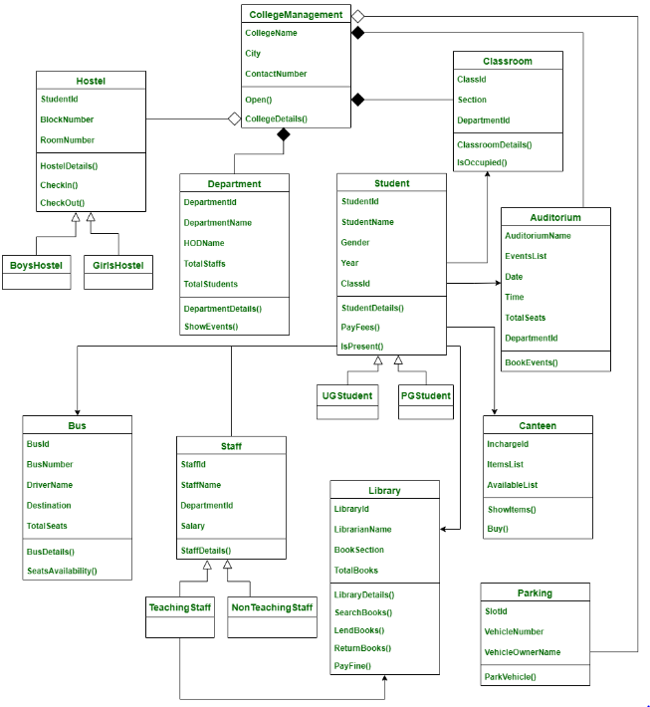
Class Diagram
Figiure 2. Class Diagram College Information System

Slide 24
Library Management System :
Classes of Library Management System :
Library Management System class – It manages all operations of Library Management System. It is central part of organization for which software is being designed.
User Class – It manages all operations of user.
Librarian Class – It manages all operations of Librarian.
Book Class –It manages all operations of books. It is basic building block of system.
Account Class –It manages all operations of account.
Library database Class –It manages all operations of library database.
Staff Class –It manages all operations of staff.
Student Class –It manages all operations of student.

Slide 25
Library Management System Cont..
Attributes of Library Management System :
Library Management System Attributes – UserType, Username, Password
User Attributes –Name, Id
Librarian Attributes –Name, Id, Password, SearchString
Book Attributes –Title, Author, ISBN, Publication
Account Attributes –no_borrowed_books, no_reserved_books, no_returned_books, no_lost_books fine_amount
Library database Attributes –List_of_books
Staff Class Attributes –Dept
Student Class Attributes –Class

Slide 26
Library Management System Cont..
Methods of Library Management System :
Library Management System Methods –Login(), Register(), Logout()
User Methods –Verify(), CheckAccount(), get_book_info()
Librarian Methods –Verify_librarian(), Search()
Book Methods –Show_duedt(), Reservation_status(), Feedback(), Book_request(), Renew_info()
Account Methods –Calculate_fine()
Library database Methods –Add(), Delete(), Update(), Display(), Search()

Slide 27
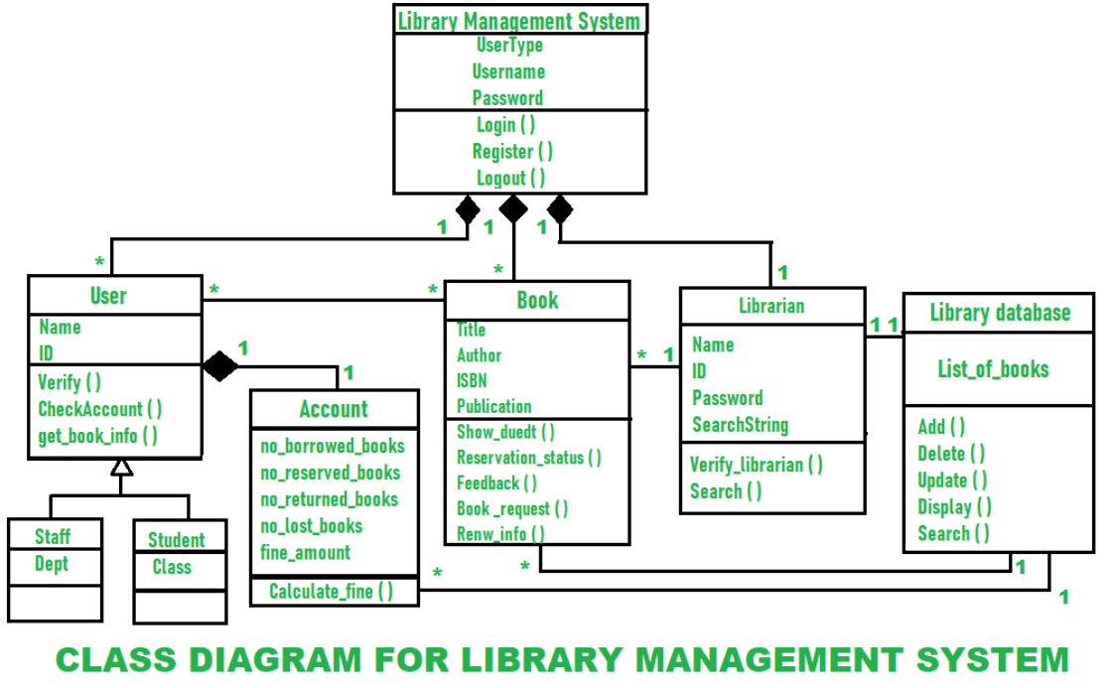
Class Diagram
Figiure 3. Class Diagram Library Management System

Slide 28
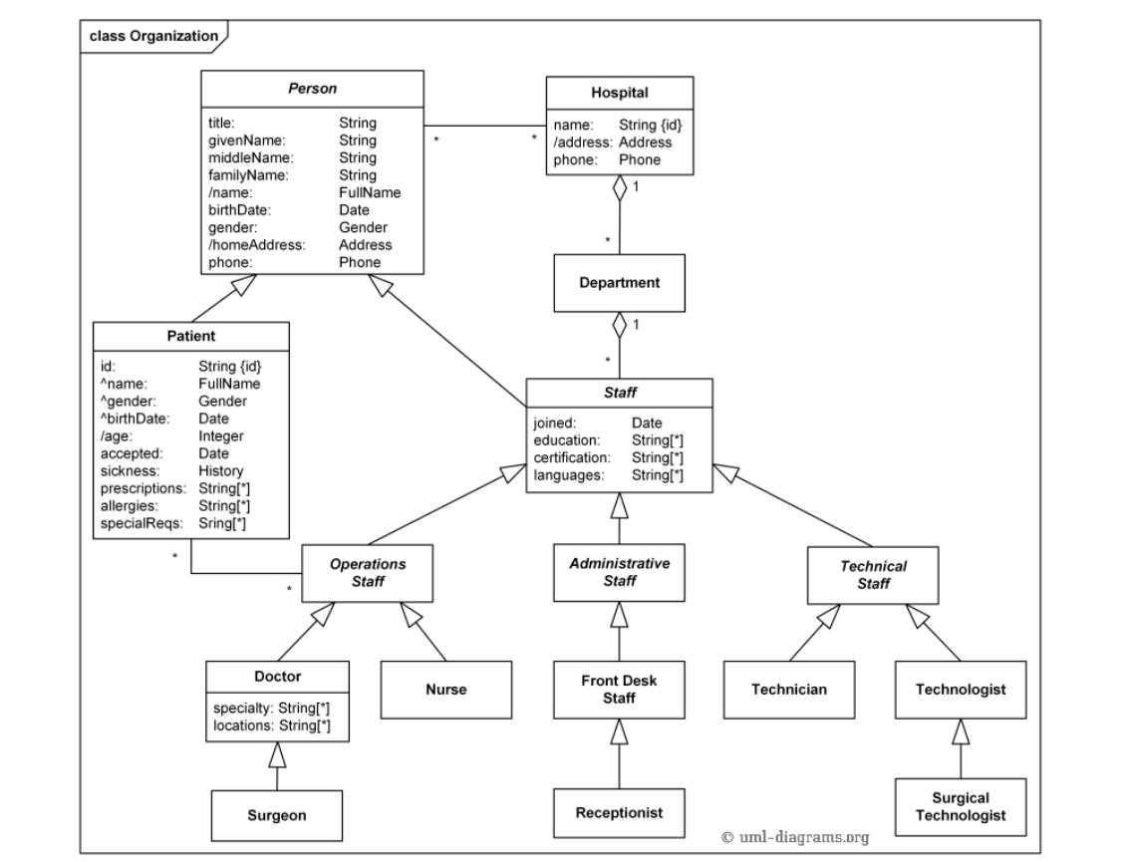
Hospital Management System
Figiure 4. Class Diagram Hospital Management System

Slide 29
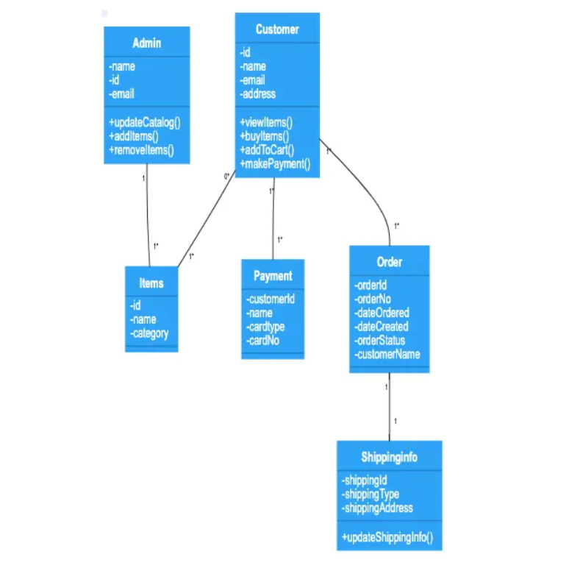
Online Shopping System
Figiure 5. Class Diagram Online Shopping System

Slide 30
Practice Questions
What is multiplicity or cardinality in class diagrams?
In UML diagrams, there are most often six types of relationships between classes. What are they?
What UML diagram types can be created?

Slide 31
Bibliography
https://www.gleek.io/blog/uml-diagram-types
https://www.gleek.io/blog/class-diagram-arrows
https://www.geeksforgeeks.org/class-diagram-for-library-management-system/
https://creately.com/diagram/example/gsxncbybs/hospital-management-system-class-diagram

Slide 32
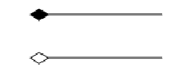
Practice Questions
1. What type of core-relationship is represented by the symbol in the figure below?
Aggregation
Dependency
Generalization
Association
2. Structure diagrams emphasize the things that must be present in the system being modeled. a) True b) False
3. _________________ allows us to infer that different members of classes have some common characteristics.
Aggregation
Dependency
Realization
Generalization

Slide 33
Practice Questions
4. A design document is a complete engineering design specification composed of?
Software Architecture Document(SAD)
Detailed Design Document(DDD)
All of the mentioned
None of the mentioned
5. Which Model describes the static structure of the system using object classes and their relationships?
Sequence Model
Subsystem Model
Dynamic Model
Structural Model

